Slide 1

WELCOME CLASS!
PROJECT #2 FINISHED – MINI PROJECT
MEETING #8
01/05/2022

Slide 2

What are we doing today?
Warm-up exercise ☺
Draw a big snowflake ☺
Write in a multiplication pattern ☺

Slide 3
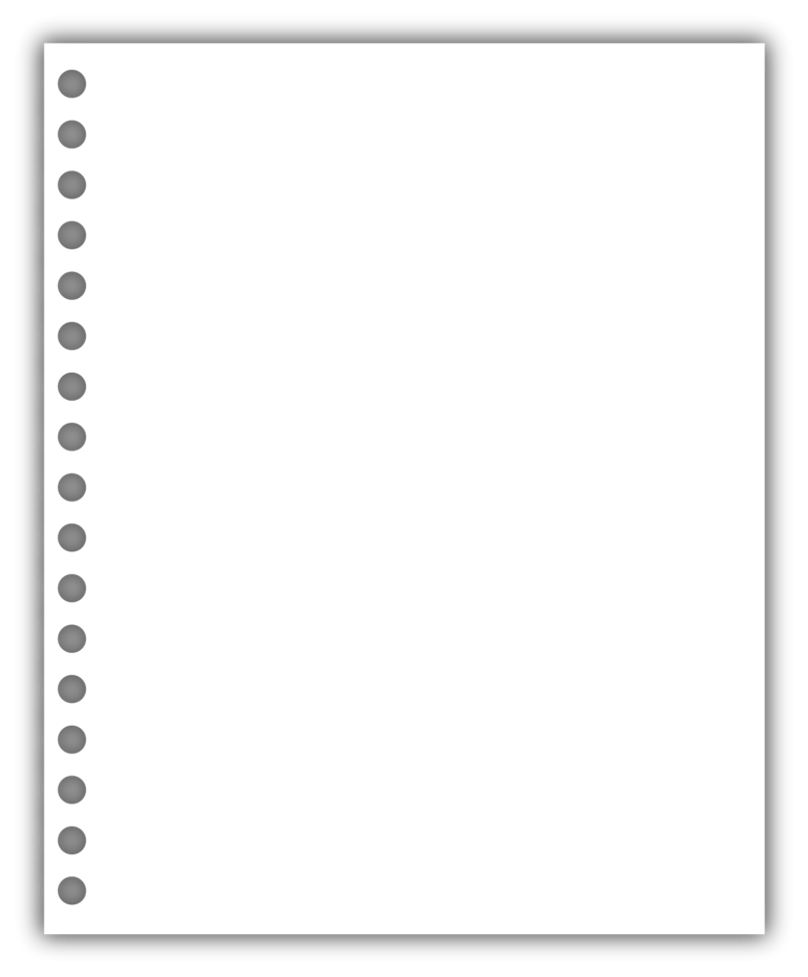
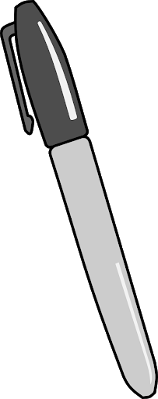
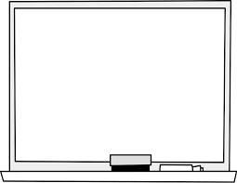

Materials: gather these items for today!
- Your drawing pad, coloring utensils, and marker board supplies ☺

Slide 4
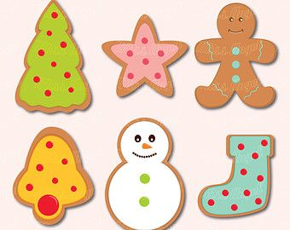

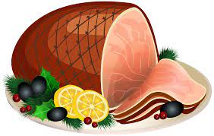
Warm-up exercise: Draw a quick doodle of One food that you ate over the holiday break! ☺

Slide 5

First, we will draw this snowflake together

Slide 6

Next, we will draw a target in the middle and write in numbers to multiply or divide by on each point

Slide 7

See you all Next time! ☺

