Slide 1


Slide 2
Wayne thiebault
Second grade gumball machine and place value

Slide 3
Wayne Thiebauld Contemporary
ARTIST
SECOND GRADE GUMBALL MACHINE AND PLACE VALUE
Leigh Pawling January 2022

Slide 4
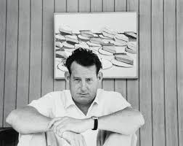
Wayne Thiebald was born on November 15, 1920
He is an American contemporary painter

Slide 5
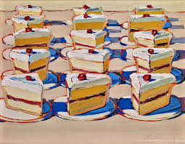
He painted slices of pie!

Slide 6
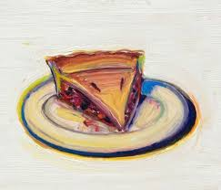

Slide 7
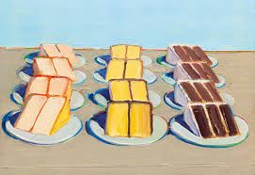
And slices of cake!

Slide 8
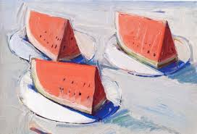
And watermelon too!!!

Slide 9
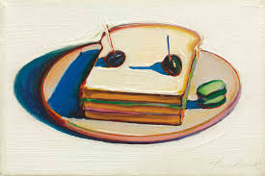
And funny looking sandwiches with olives on top!

Slide 10
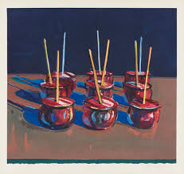
And beautiful candy!

Slide 11
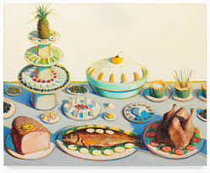
Did you ever think of using food as something really neat to paint?

Slide 12
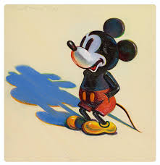
And he Mickey Mouse!!!

Slide 13
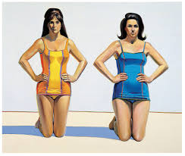
And he painted the human figure! What a range of styles!

Slide 14
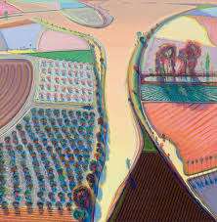
All his food paintings led to painting landscape - look at all the yummy cool!

Slide 15


His art work is colourful and of recognisable images, like ice cream cones, Micky Mouse, and gum ball machines.
He is part of an art movement called POP art!

Slide 16
materials
For this lesson

Slide 17
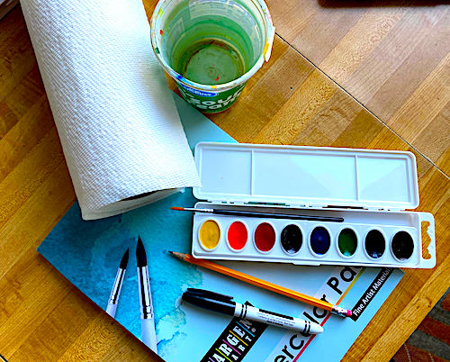
Supplies you will need -
WATERCOLOR PAD
WATERCOLORS
CONTAINER FOR WATER

Slide 18
materials
Pencil
Watercolor paper
Watercolors
Black marker

Slide 19
objectives
of this lesson

Slide 20
objectives
To learn placement of circles
To learn thirds
To learn place value
To learn doubling numbers
To learn mixing secondary colors from primary colors
To learn complementary colors
To work the whole producing a piece of art inspired by Wayne Thiebault

Slide 21
vocabulary
Thirds
Multiples
Primary colors
Secondary colors
Complementary colors
Odd and even

Slide 22
Pass or play!
How many gumballs?

Slide 23
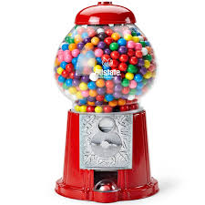
PASS OR PLAY
How many gum balls do you think are in this gum ball machine?

Slide 24
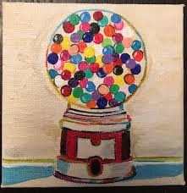
Here is a painting Wayne Thiebauld did of a gum ball machine

Slide 25
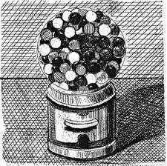
Can’t you almost SEE the cooler of these gum balls?

Slide 26
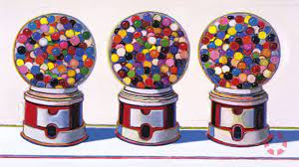

Slide 27
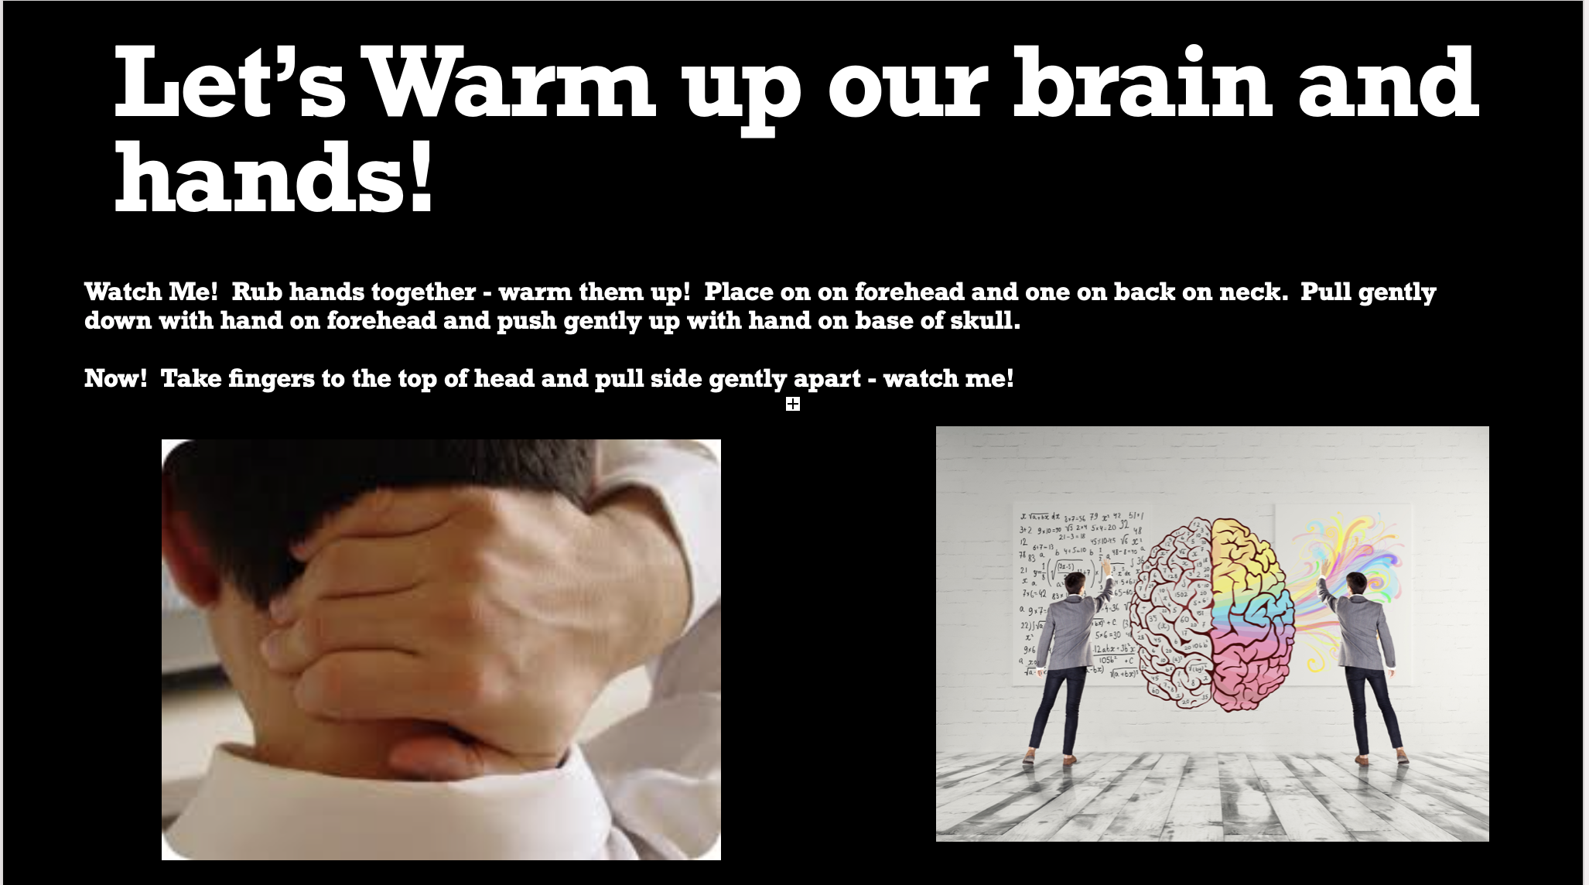

Slide 28
instructions
Divide paper into thirds
Draw three circles the same size on the upper half of paper
We will be doing 10 gumballs in first machine, 20 in second and 30 in the third one.
We will mix green filling it with two gumballs in first machine, four in second and six in third.
We then will work on mixing green and filling it with three gumballs in first gumball machine, six in the second and nine in the third.
We then will mix purple and fill it in four gumballs in the first machine, eight in the second and twelve in the third.
The backgrounds will be purple, green and orange for which they mix.
We will work on curved steps on some balls as well as striped background

Slide 29
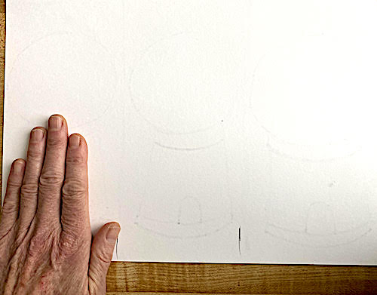
First we divide our paper into thirds. We can use a ruler or use our hand (with thumb) as a way to measure!

Slide 30
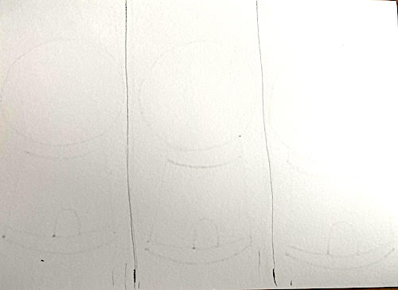
Now
Draw two lines to make our paper into thirds!

Slide 31
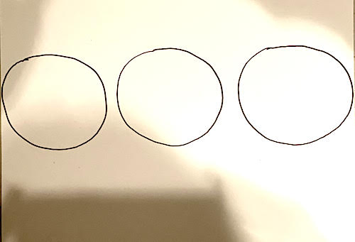
Now we draw THREE CiRCLES - watch were I place them!

Slide 32
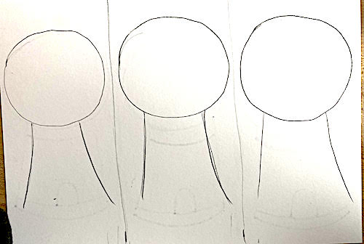
Now we’re going to do some curved lines!

Slide 33
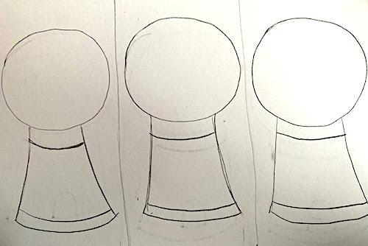
Some more curved lines! Watch me in my studio!

Slide 34
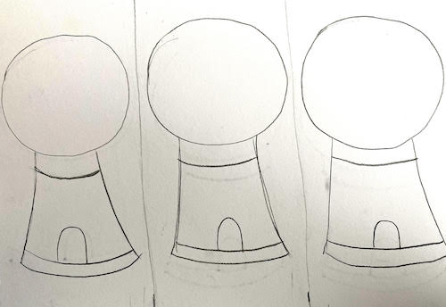
Now, upside down letter U for where the gumball comes out!

Slide 35
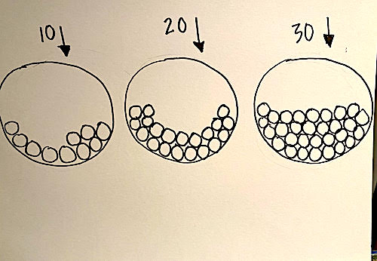
Next, we’re going to TAKE OUR TIME and do TEN gum balls in one circle
TWENTY in the next
and
THIRTY in the next!

Slide 36
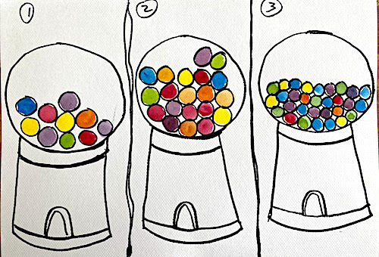
First, we use our primary colors YELLOW, RED, and BLUE in each gum ball machine. Then, we make the SECONDARY colors, ORANGE, GREEN and PURPLE gum balls!

Slide 37
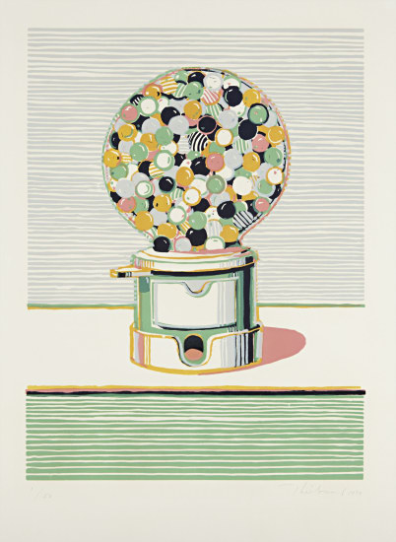
Here we are furthered inspired by a Wayne Thiebauld gum ball machine. Lets add some stripes to help show the curve of the gum balls and to make the background fun!

Slide 38
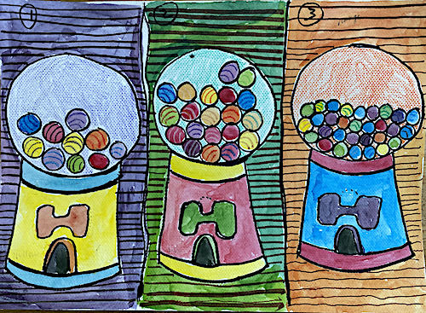
Complementary colors are used for the background - multiplies of 2, 4, 6 for yellow gumballs then 3,6,9 for red and 4,8,12 for blue we are working with sequences! And then added stripes
To show dimension. All done by example step by step in studio~!

Slide 39
references

Slide 40
references
4 sactownmag.com
5 crockerart.org
6 studiointernational.com
7 mutualart.com
8 sjmusart.org
9 artnet.com
10 crownpoint.com
11datebook.sfchronicle.com
12 news.artnet.com
13. nytimes.com
14. theguardian.com
15 sactownmag.com
23 amazon.com
24 lempertz.com
25 dawsoncolefineart.com
26 art.famst.org

